Slide 1

Energy Management in Power Distribution Systems:
Review, Classification, Limitations and Challenges
Li Jiajun Guo Xinyu Hou Yuhan Liu Yaxuan

Slide 2
CONTENTS
01
Contents and Motivation
Paper Classfication Based on the Goal of Energy Management
02
Based on Optimization Approach
03
Paper Classfication Based on the EM approach
04
05
Limitation and Conclusion

Slide 3
Content of this paper
Performing a thorough and current literature review on energy management
Summarizing and categorizing the work based on key factors
Organizing and discussing effective techniques and methodologies employed or developed
Analyzing published papers, highlighting challenges and limitations, addressing open question.

Slide 4
Motivation
1
Importance of the Subject
To address rising energy demands, mitigate environmental pollution, and achieve socio-economic benefits for sustainable development.
2
Summarizing the Literature
Offering a consolidated overview of current research to guide researchers in making informed decisions.
3
Time Saving Manual
A valuable community service by providing researchers with a time-saving and easily accessible guideline.

Slide 5
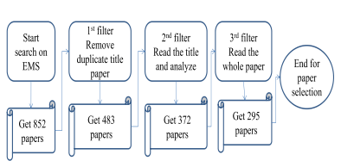
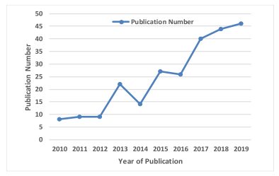
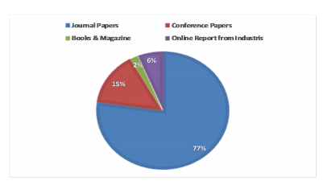
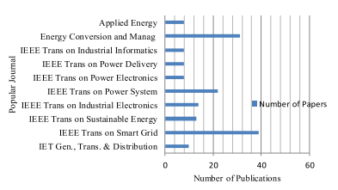
Paper search and analysis
Searching technique and
paper selection procedure
Frequency of publications
Data analysis

Slide 6
02
PART
PAPER CLASSIFICATION
BASED ON
THE GOAL OF ENERGY MANAGEMENT

Slide 7
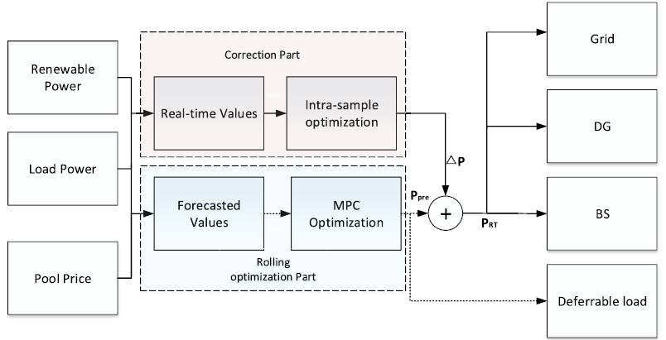
MINIMIZING THE OPERATIONAL COSTS
Energy management greatly helps to reduce the system’s operational costs. It can optimize the share of energy generation for the generators and avoid expensive energy sources based on the demand requirements, especially during peak hours.
Fig. 1. Block diagram of the proposed online EMS system.
M. S. Taha, H. H. Abdeltawab, and Y. A.-I. Mohamed, ``An online energy management system for a grid-connected hybrid energy source,'' IEEE J. Emerging Sel. Topics Power Electron., vol. 6, no. 4, pp. 20152030, Dec. 2018.

Slide 8
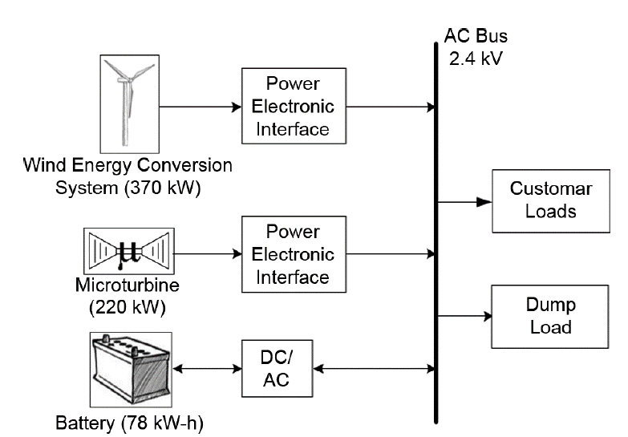
MINIMIZING THE POLLUTANT EMISSIONS
The energy management system has a significant role in minimising the greenhouse gas effects by properly managing and controlling energy sources in distribution systems while concentrating on the system’s reliability and efficiency.
Fig. 2. Configuration of the proposed system.
S. A. Pourmousavi, M. H. Nehrir, C. M. Colson, and C.Wang, ``Real-time energy management of a stand-alone hybrid wind-microturbine energy system using particle swarm optimization,'' IEEE Trans. Sustain. Energy, vol. 1, no. 3, pp. 193201, Oct. 2010.

Slide 9
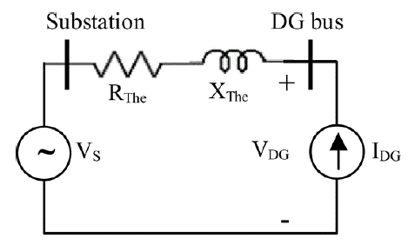
IMPROVING STABILITY OF VOLTAGE PROFILE
Voltage stability is a concern in distribution systems which could happen due to the fluctuation of loads or generator outage. In a modern distribution system, the demand response program allows the utility to take the load in an optimized way.
Fig. 3. Thevenin equivalent of a system with DG.
K. M. Muttaqi, A. D. T. Le, M. Negnevitsky, and G. Ledwich, ``An algebraic approach for determination ofDGparameters to support voltage
profiles in radial distribution networks,'' IEEE Trans. Smart Grid, vol. 5, no. 3, pp. 13511360, May 2014.

Slide 10
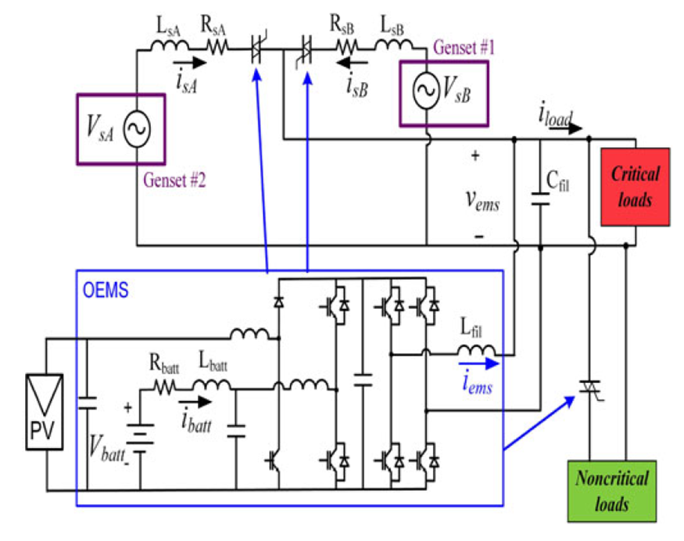
INCREASING THE SYSTEM RELIABILITY AND MINIMIZING OUTAGE DURATION
EMS reviews the data for all the devices connected to the power network by data centre utilization and identifies the zones with peak capacity or underperforming capacity. The system reliability could be improved by optimally managing the ESS, DR, and EV using EMS in a distribution system.
Fig. 4. Optimized energy management system architecture.
N. Anglani, G. Oriti, and M. Colombini, ``Optimized energy management system to reduce fuel consumption in remote military microgrids,'' IEEE Trans. Ind. Appl., vol. 53, no. 6, pp. 57775785, Nov./Dec. 2017.

Slide 11
INCREASING THE SYSTEM EFFICIENCY
Energy management helps utility companies to monitor the energy distribution in an optimized way. With the development of technology (IOT sensors), the consumer can get updated energy usage data from the system and optimize energy saving by re-scheduling the energy-consuming devices, or in some cases upgrading the energy-inefficient devices.
In addition, energy management can monitor and control the energy resources located at the consumer side, help to reduce the transmission line stress, and reduces the system loss, which ultimately increases the system efficiency.

Slide 12

03
PART
BASED ON OPTIMIZATON APPROACH

Slide 13
GA
Genetic algorithm
PSO
Particle Swarm Optimization
UC
Unit Commitment
MILP
Mixed-Integer Linear Programming
ABC
Artificial bee colony
TS
Tabu Search
Based on Optimization Approach
ACO
Ant Colony
Optimization
Fuzzy Logic
Heuristic
Heuristic Optimization
Multi Agent
MPC
Model Predictive Control
MINLP
Mixed-Integer Nonlinear Programming
Game Theory

Slide 14

Based on Optimization Approach
The Particle Swarm Optimization and the Fuzzy Logic are the two mostly used and efficient techniques used for solving energy management problems.
01
PSO
02
Fuzzy Logic
Developed a simplified algorithmic model, which was improved over the years culminating in the Particle Swarm Optimization(PSO).
In the real world many times we encounter a situation when we can’t determine whether the state is true or false, their fuzzy logic provides very valuable flexibility for reasoning.
Notes:
In 1995, inspired by the regularity of the foraging behaviour of flocks of birds, James Kennedy and Russell Eberhart developed a simplified algorithmic model, which was improved over the years culminating in the Particle Swarm Optimization(PSO).
The term fuzzy refers to things that are not clear or are vague. In the real world many times we encounter a situation when we can’t determine whether the state is true or false, their fuzzy logic provides very valuable flexibility for reasoning. In this way, we can consider the inaccuracies and uncertainties of any situation.

Slide 15
PSO
Comparative
Unlike GA, PSO does not have evolutionary operators such as crossover and mutation.
Source of inspiration
When a bird flies randomly and searches for food, all the birds in the flock can share their findings and help the whole flock get the best hunt.
Advantages
The algorithm has very few parameters.
Very efficient global search algorithm.
Easy parallelisation for concurrent processing
Limitation
This is a heuristic solution because we can never prove that a true global optimal solution can be found.
Notes:
Limitations: The optimal solution found by the flock of birds is the best solution in space.
与 GA 不同，PSO 没有进化算子，如交叉和突变。不可否认，PSO 的缺点包括实用性和准确性都不如 GA
虽然我们可以模拟一群鸟的运动，但我们也可以想象每只鸟都在帮助我们在高维解空间中找到最优解，而鸟群找到的最优解就是空间中的最佳解。这是一个启发式解决方案，因为我们永远无法证明可以找到真正的全局最优解决方案，而且通常不是。然而，我们经常发现PSO找到的解非常接近全局最优。
与 GA 不同，PSO 没有进化算子，例如交叉和突变。在 PSO 中，潜在的解（称为粒子）通过遵循当前最优粒子在问题空间中移动。PSO在速度和内存要求方面都具有更高的计算效率。PSO不可否认的缺点包括它比GA更不实用和不准确。

Slide 16
PSO example
Optimisation issues in articles:
1. In order to estimate the nodal voltage, a power flow
analysis (which is an iterative based approach) is required;
2. The diesel generators have two non-continuous states of operation(ON/OFF).
Cannot be solved with precise optimisation
A two-stage particle swarm algorithm is used to solve the optimisation problem. Set particles for multiple iterations. An external PSO optimises the siting and sizing of the dg, PV and battery.
Rodríguez-Gallegos, Carlos D., et al. "A siting and sizing optimization approach for PV–battery–diesel hybrid systems." IEEE Transactions on Industry Applications 54.3 (2017): 2637-2645.
Notes:
PSO 27
目前的优化问题不能用精确的优化方法来解决，因为:1。为了估计节点电压，需要进行潮流分析(一种基于迭代的方法);2. diesel generators(DGs)有两种非连续的操作状态(开/关)。
因此，不能使用凸优化方法。因此，采用了一种元启发式算法，即粒子群算法。这是一种广泛使用的算法，具有以下特点:易于实现，所有候选解具有平等的进化机会，计算机内存需求低等[26]。尽管元启发式算法不能保证得到全局解，但如果设计得好，可以得到一个足够好的解。
采用两阶段粒子群算法求解优化问题。首先，外部的psosi优化dg、PV和电池的选址和尺寸，而内部的psosch优化它们的调度。

Slide 17
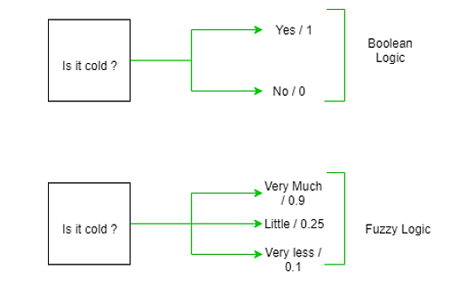
Fuzzy Logic
In Boolean system truth value, 1.0 means absolute truth value and 0.0 means absolute false value. But in fuzzy system there is no logic in absolute true value and absolute false value.
Fuzzy logic is used in a wide range of applications such as control systems, image processing, natural language processing, medical diagnostics and artificial intelligence.
It allows for partial truths, in which statements can be partially correct or incorrect, rather than completely correct or incorrect.
Notes:
模糊逻辑是多值逻辑的一种形式，其中变量的真值可以是 0 到 1 之间的任何实数，而不仅仅是传统的 true 或 false 值。它用于处理不精确或不确定的信息，是一种表示决策中的模糊性和不确定性的数学方法。
模糊逻辑基于这样一种观点，即在许多情况下，真或假的概念过于严格，并且介于两者之间有许多灰色阴影。它允许部分真理，其中陈述可以部分正确或错误，而不是完全正确或错误。
模糊逻辑应用广泛，如控制系统、图像处理、自然语言处理、医疗诊断和人工智能

Slide 18
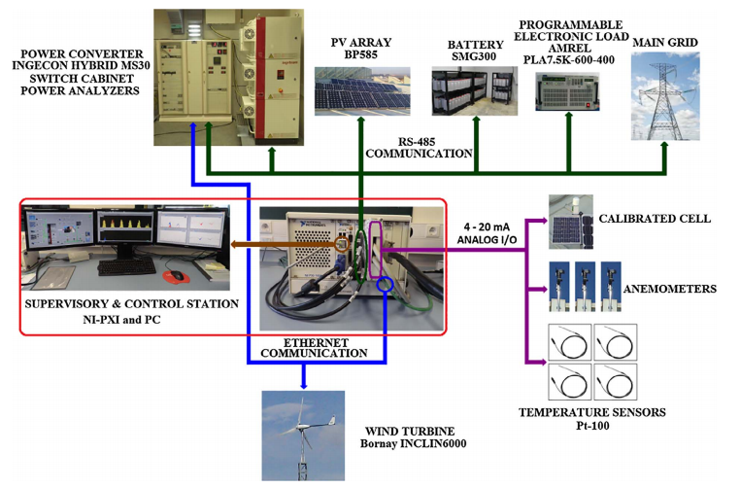
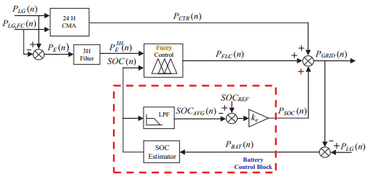
Fuzzy Logic example
Fuzzy control
Block diagram of the proposed EMS
based on microgrid power forecasting
UPNa microgrid. Configuration, components description and bus connections
The microgrid includes a renewable generation system, a programmable load, a storage system, a power converter, a weather station and, a supervisory and control station.
Arcos-Aviles, Diego, et al. "Low complexity energy management strategy for grid profile smoothing of a residential grid-connected microgrid using generation and demand forecasting." Applied energy 205 (2017): 69-84.
Notes:
the proposed fuzzy EMS-FC strategy
is performed in the real MG installed at UPNa.

Slide 19
04
PART
PAPER CLASSIFICATION BASED ON
THE EM APPROACH

Slide 20
the Different EM Approaches
1
2
3
4
5
Controlling
the Output
Power of the DGS
Capacitor
Control
EES Control
Demand
Response
System
Reconfiguration

Slide 21
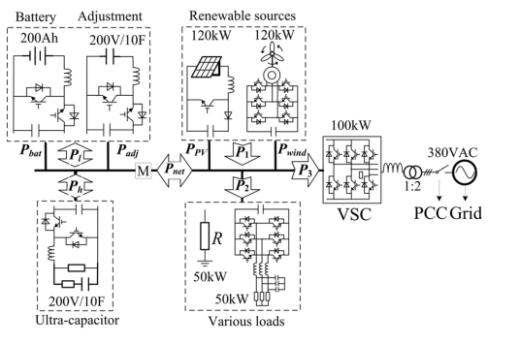
Controlling the Output Power of the DGS
Frequency Adjustment
Internal gain control
Real-time feedback
System configuration and deployment of the DC micro-grid.

Slide 22
Controlling the Output Power of the DGS
The purpose of controlling the output power of a DGS:
1.grid reinforcement
2.reduction of power losses
3.on-peak operating costs
4.improvement of voltage pro-files and load factors
The applications for controlling the output power of the DGS are widely related to the field of energy management.To name a few:
1.Load balancing in power systems
2.Power loss minimization
3.Voltage and frequency control
4.Renewable Energy Integration

Slide 23
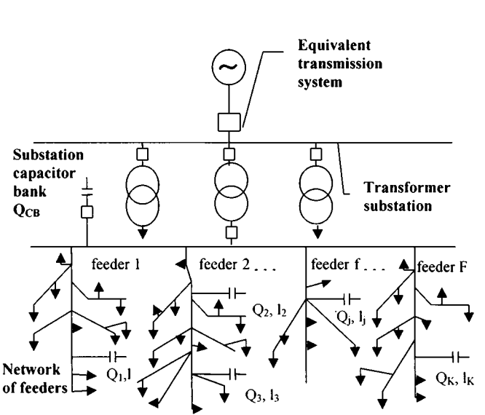
Capacitor Control
The management of capacitors in power systems is achieved by adjusting their operating conditions and parameters, which can be used to improve the power factor and voltage stability of power systems, as well as to reduce power losses.
The general distribution system model for capacitor allocation

Slide 24
Capacitor Control
The primary purpose of using a capacitor bank is to provide reactive power in a system, which is typically used to correct the power factor or phase shift inherent in an AC power supply.
Capacitor banks are widely used because of their efficiency in reactive power compensation. Installing capacitor banks at optimum locations and controlling them can help to significantly reduce system losses, maintain voltage regulation, and provide economic benefits to distribution companies.

Slide 25
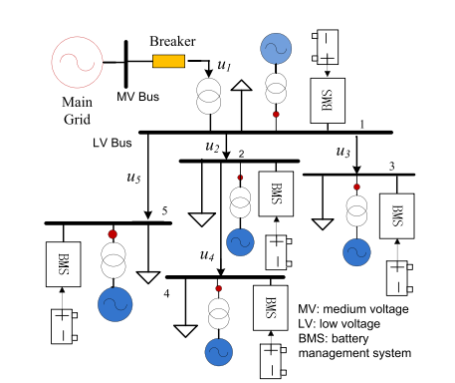
EES Control
Manage and optimise the energy storage and release process by adjusting the operating states and parameters of the energy storage system.
EES control is commonly used in microgrids, distributed generation systems and other fields.
Topology of a 5-bus MG

Slide 26
Demand Response
Adaptation of the supply-demand balance and optimisation of energy use by adjusting the behaviour of end-users in the use of electricity, for example, reducing the load demand or postponing the use of electricity during periods of shortage.
The primary goal of demand response is to improve the stability, reliability and efficiency of the power system.
It has a wide range of applications in industrial, commercial and residential electricity use.

Slide 27
System Reconfiguration
The principle of system reconfiguration is to achieve the objectives of load balancing, reduction of line losses, and improvement of voltage quality by changing line connections and switching states in the distribution network.
the function of system reconfiguration:
1.improve the efficiency, reliability and stability of the distribution system
2.reduce load imbalance and improve current distribution uniformity
3.reduce line losses and improve voltage stability and quality
Mainly used in urban distribution grids, industrial parks, microgrids.

Slide 28
05
PART
LIMITATION AND CONCLUSION

Slide 29
Limitation and challenges
Privacy
Reliability
Private information such as customer location
Reliability in off grid operations
Complexity
Constraints
Energy management for large numbers of sites
Constraints involved for performing EMS in the distribution system
Update and maintenance
Properly establish energy baselines and adapt them to annual reviews of system performance

Slide 30
Future works
Emissions
Miscellaneous
A
B
C
D
System Upgrade
Using DERs
Reconfiguration cost

Slide 31
Conclusion
Comprehensive review of energy management in distribution systems.
Analysis of papers from diverse sources and perspectives.
Identification of challenges, including consumer reluctance and reliability concerns.
Emphasis on increasing interest in academic and industrial sectors.
Significance of energy management for sustainability and efficiency.
Insights for future research directions, saving valuable time for researchers and engineers.

Slide 32
References（Selected）
[1]Y. Xu and X. Shen, "Optimal Control Based Energy Management of Multiple Energy Storage Systems in a Microgrid," in IEEE Access, vol. 6, pp. 32925-32934, 2018, doi: 10.1109/ACCESS.2018.2845408.
[2]B. Liu, F. Zhuo, Y. Zhu and H. Yi, "System Operation and Energy Management of a Renewable Energy-Based DC Micro-Grid for High Penetration Depth Application," in IEEE Transactions on Smart Grid, vol. 6, no. 3, pp. 1147-1155, May 2015, doi: 10.1109/TSG.2014.2374163.
[3]C. D. Rodríguez-Gallegos, O. Gandhi, D. Yang, M. S. Alvarez-Alvarado,
W. Zhang, T. Reindl, and S. K. Panda, "A siting and sizing optimization
approach for PV–battery–diesel hybrid systems," IEEE Trans. Ind. Appl.,
vol. 54, no. 3, pp. 2637–2645, May/Jun. 2018
[4]S. A. Alavi, A. Ahmadian, and M. Aliakbar-Golkar, "Optimal prob_x0002_abilistic energy management in a typical micro-grid based-on robust
optimization and point estimate method," Energy Convers. Manage.,
vol. 95, pp. 314–325, May 2015.
[5]D. Arcos-Aviles, J. Pascual, F. Guinjoan, L. Marroyo, P. Sanchis, and
P. M. Marietta, "Low complexity energy management strategy for grid
profile smoothing of a residential grid-connected microgrid using gen_x0002_eration and demand forecasting," Appl. Energy, vol. 205, pp. 69–84,
Nov. 2017.

Slide 33
THANKS

